Slide 1


Slide 2
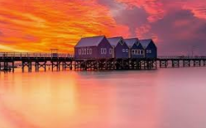
VOCA RALLY 2027
Busselton WA - 11 March to 17 March

Slide 3
Busselton Historic Jetty & Underwater Observatory
Extending 1.841 kilometers over the protected waters of Geographe Bay, the heritage
Busselton Jetty is the longest timber-piled jetty in the southern hemisphere and is
home to one of six Underwater Observatories in the world.
Embark on a 1.7km journey across the peaceful waters of Geographe Bay aboard the
Rio Tinto Solar Express
Descend 8 metres below the ocean to discover more than 300 different marine species.
Inside the 9.5 metre diameter observation chamber, 11 viewing windows offer unique
vantage points to observe the piles that create Australia's largest artificial reef.
Train & Observatory: Adult $42, Child $27
2 hours 30 minutes

Slide 4
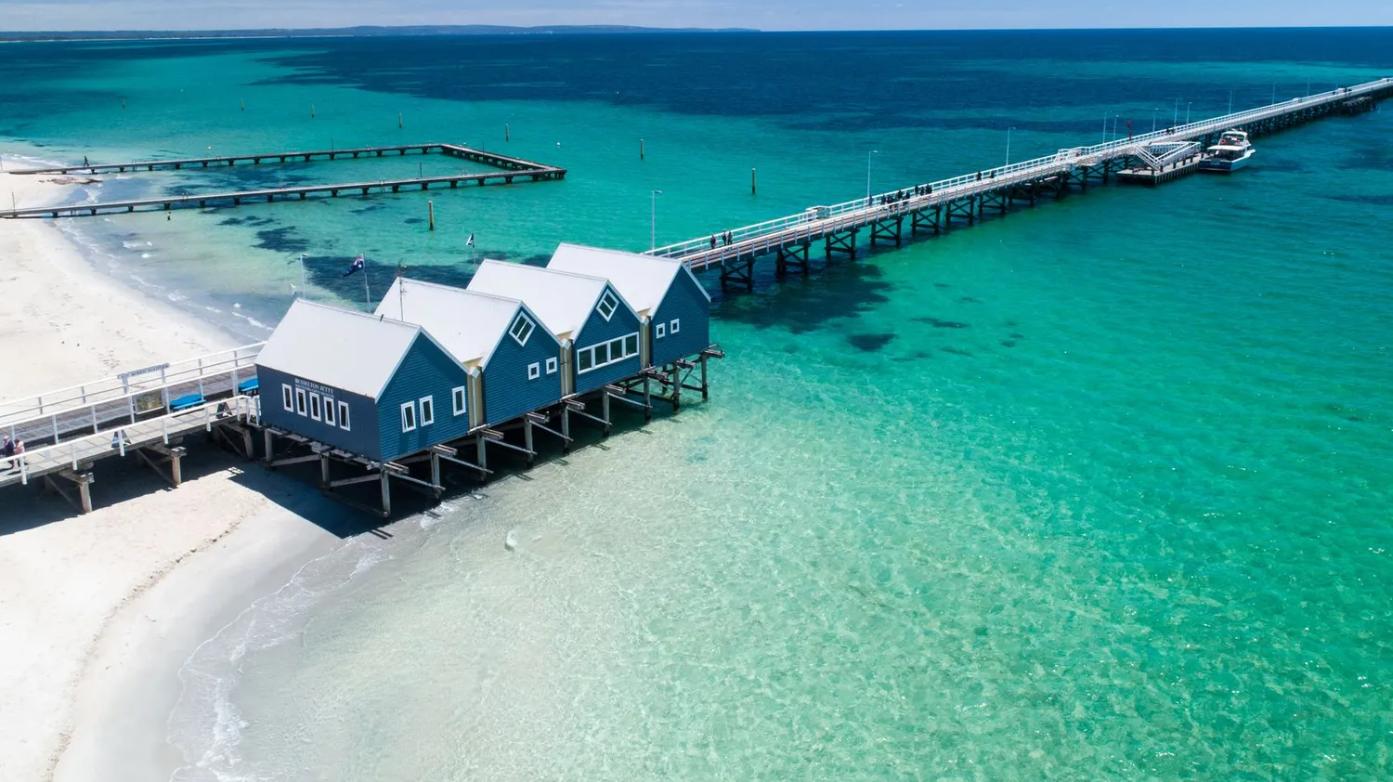
Busselton Historic Jetty

Slide 5
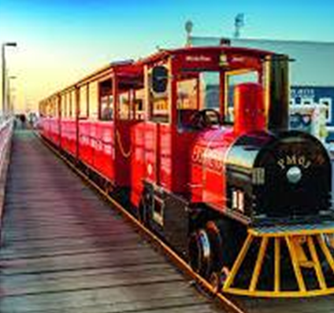
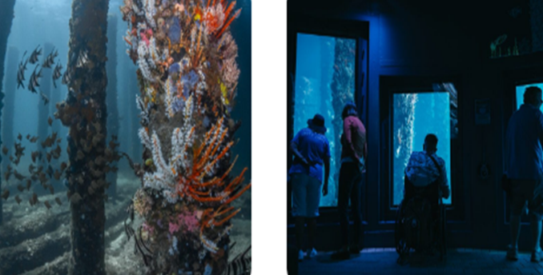
Jetty Train & Underwater Observatory

Slide 6
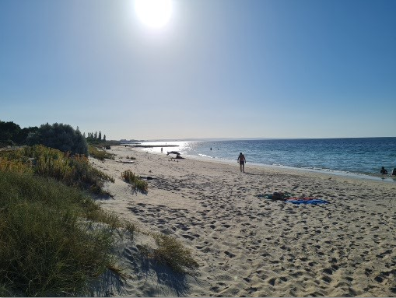
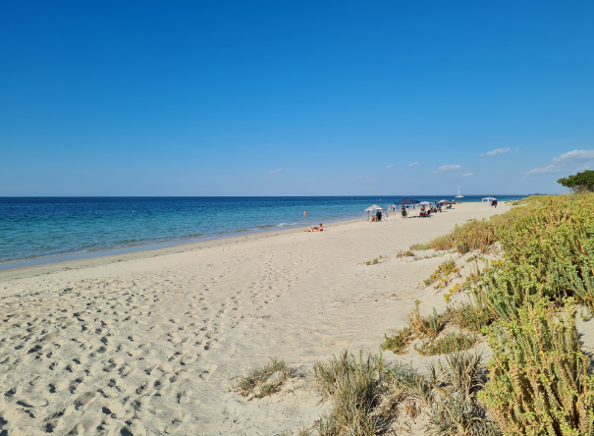
Beaches of Geographe Bay
Busselton beaches offer calm, shallow, family-friendly turquoise waters in Geographe Bay, ideal for swimming, fishing, and snorkeling.

Slide 7
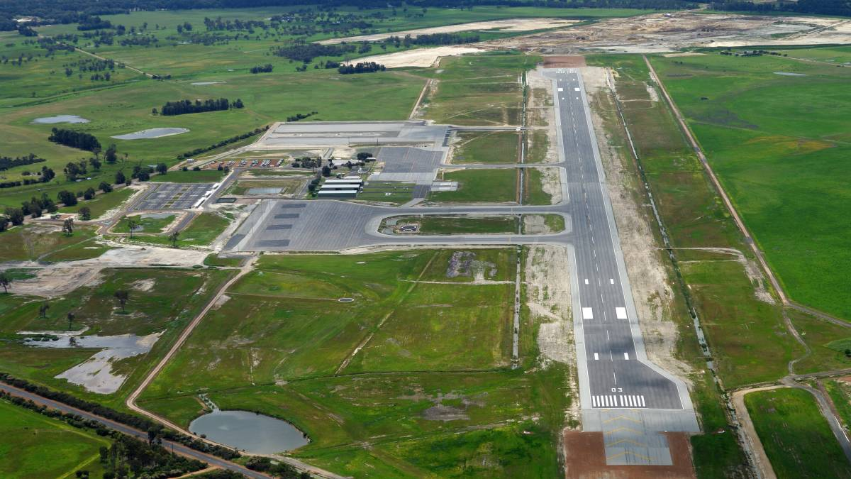
FLYING - Busselton Regional Airport
Direct flights from Sydney & Melbourne

Slide 8
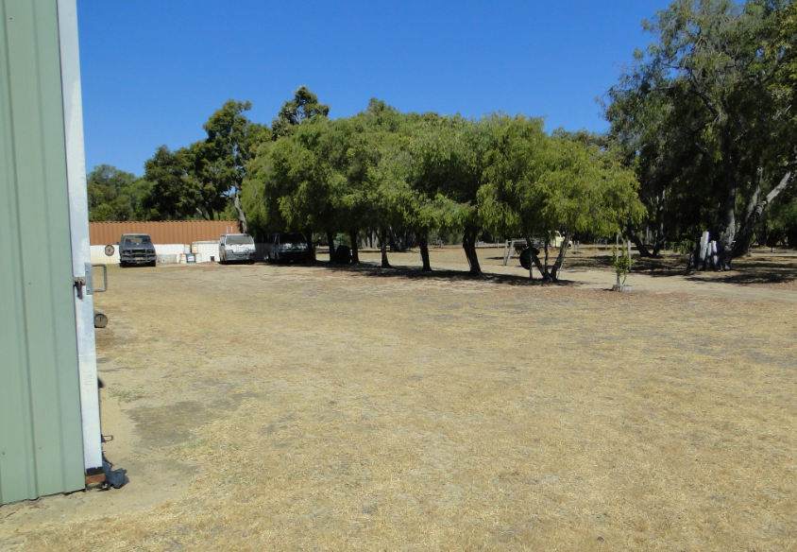
TOWING – Trailer Storage at nearby Sharps Motor Museum

Slide 9
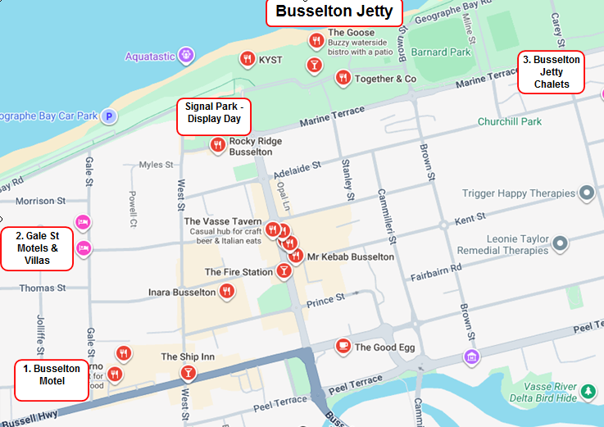

Slide 10
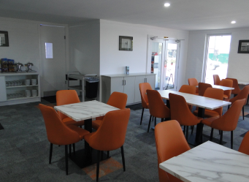
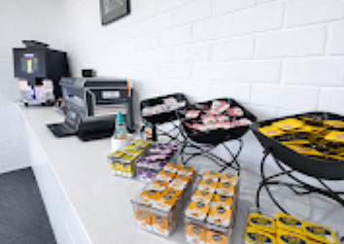
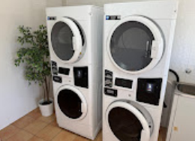
Accomodation – Motels, Chalets & Villas
3 nearby locations owned by the same Group
Recently refurbished
2026 prices locked for 2027 Rally
Prices locked for Pre & Post Rally
Conference Room
Breakfast Room
Laundry
BBQ
Self Serve Continental Breakfast
Wifi

Slide 11
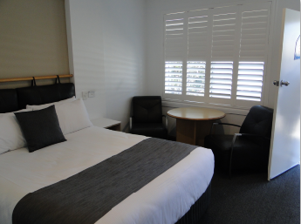
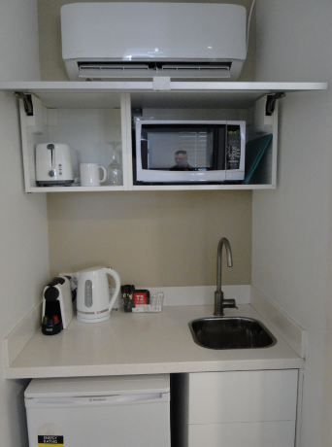
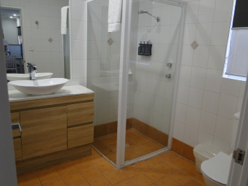
Accommodation
Motel Room examples

Slide 12
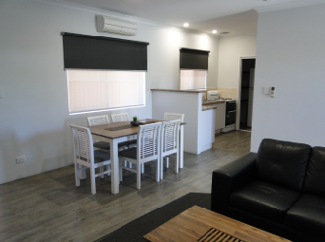
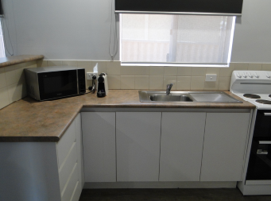
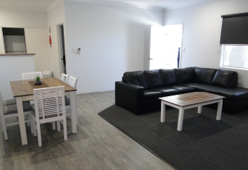
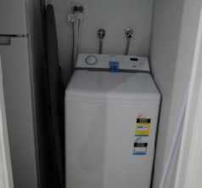
Accommodation
Villa examples

Slide 13
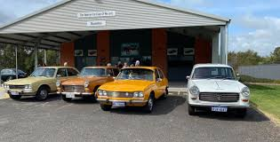
Veteran Car Club of WA Busselton Branch

Slide 14
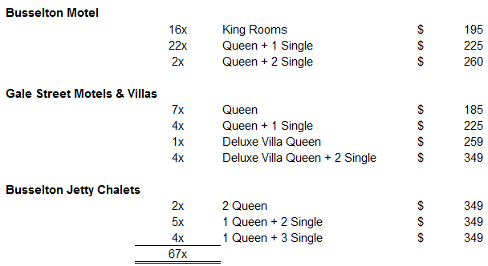
Accomodation Types & Prices

Slide 15

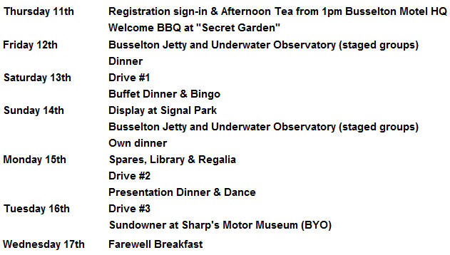
Program of Events
Entrants are encouraged to dress in the fashion appropriate to the age of their vehicle. Not only will this add to the fun of the rally but will it will encourage public interest & awareness.

Slide 16
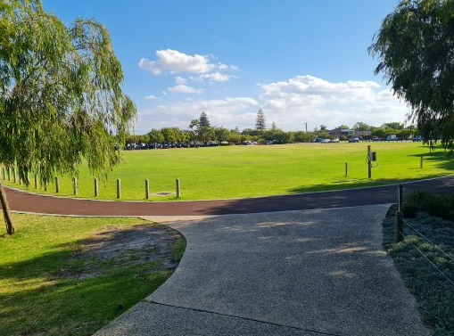
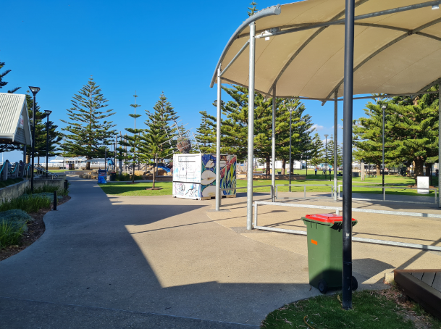
Display Day - Signal Park
Maximum Foot Traffic
Visible from Busselton Jetty
Share ground with Busselton Rotary Markets
Adjacent Public Toilet Blocks

Slide 17
Entertainment
The Busselton/Margaret River area has so much to offer that we suggest that you arrive early, or stay after the Rally, or both.
Examples of things to do include:
Wineries
Exceptional Restaurants (including many with degustation menus)
Caves (Mammoth, Lake, Jewel)
Mini Golf
Mazes
Birds of Prey Encounters

Slide 18
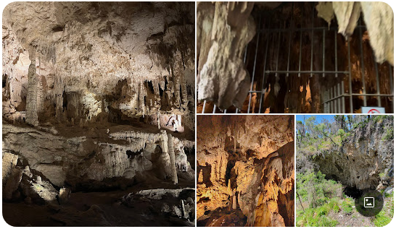
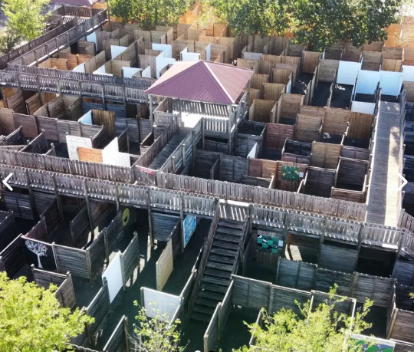
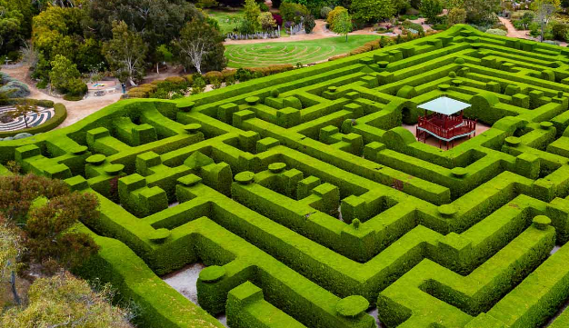
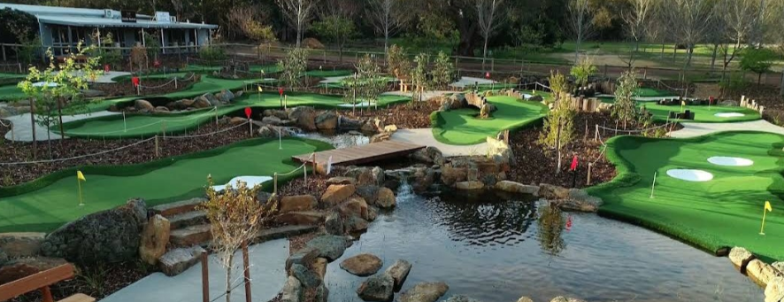

Slide 19
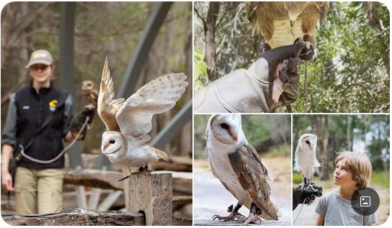
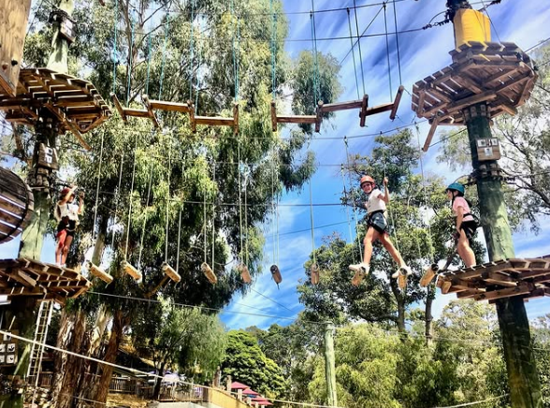

Slide 20
Further information contact
Robert Ingley
email: robert,ingley@gmail.com
mobile: 0422 241 090 (text only please)
Jim Selkirk
email: hellenjim@bigpond.com
mobile: 0409 720 620
Peter Temple
email: pte67433@bigpond.net.au
mobile: 0414 462 195

